Slide 1
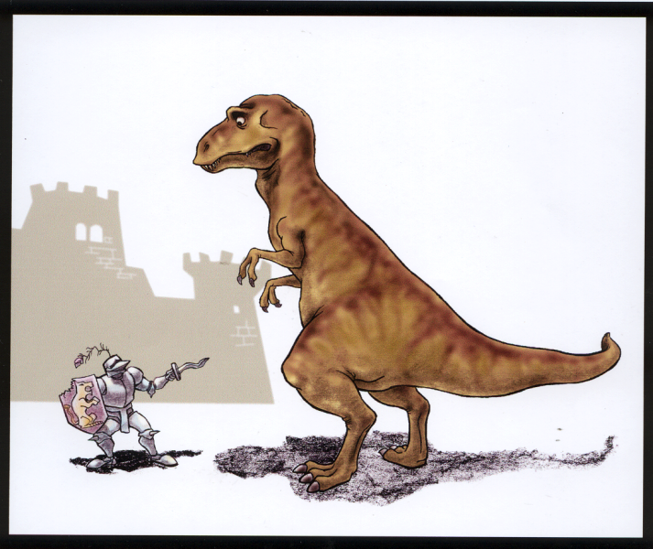

Slide 2
“If Jesus was not the redeemer who died for
our sins, and this is
what evolution means,
then Christianity
is nothing.”
G. Richard Bozarth
The Meaning of Evolution
Journal of American Atheists, Feb 1978

Slide 3
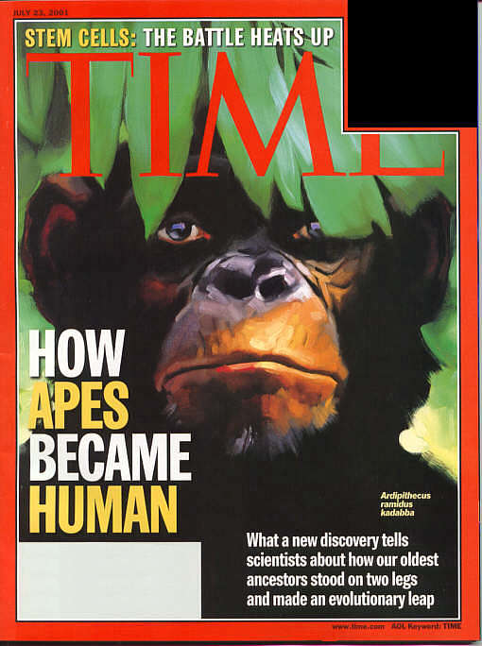


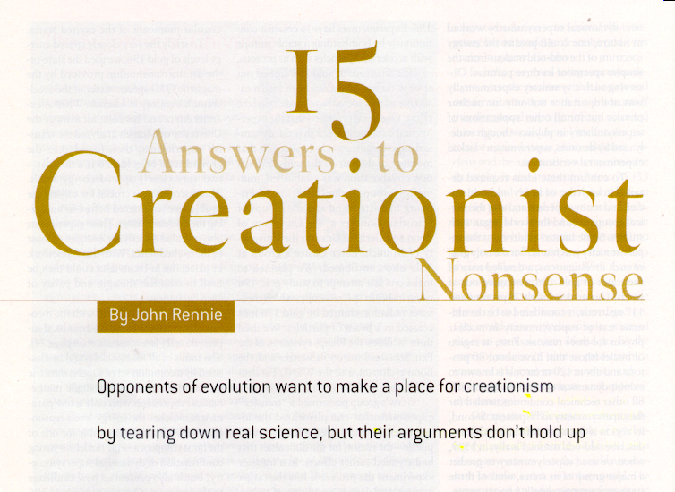

Slide 4

“A central tenet of modern science is methodological naturalism – it seeks to explain the universe purely in terms of observed or testable natural mechanisms.”
John Rennie
Editor in Chief of SciAm
Scientific American, July 2002, p84

Slide 5
Max Planck
Vorträge and Erinnerungen
S. Hirzel-Verlag, Stuttgart
1949, p13
A new scientific truth is usually not propagated in such a way that opponents become convinced and discard their previous views.
No, adversaries eventually die off, and the upcoming generation is familiarized anew with the truth.

Slide 6
Genesis 1
In the beginning God... Gen 1:1
Day 1: Space, Time, Water and Energy
Day 4: Sun, Moon and Stars
Day 2: Atmosphere
and Sky
Day 5: Flying and Swimming Creatures
Day 3: Dry Land and Vegetation
Day 6: Land Creatures and Man
And it was very good. Gen 1:31
Notes:
5

Slide 7
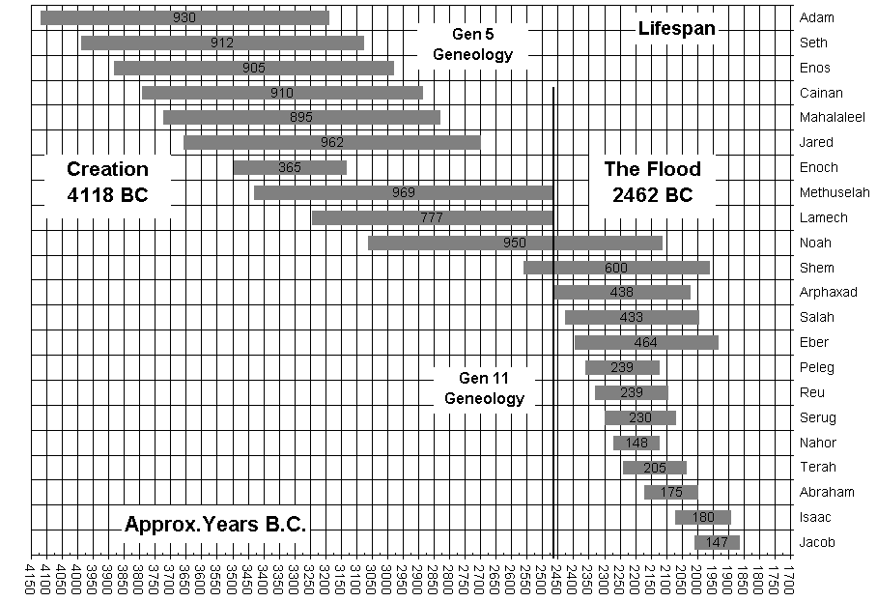

Slide 8
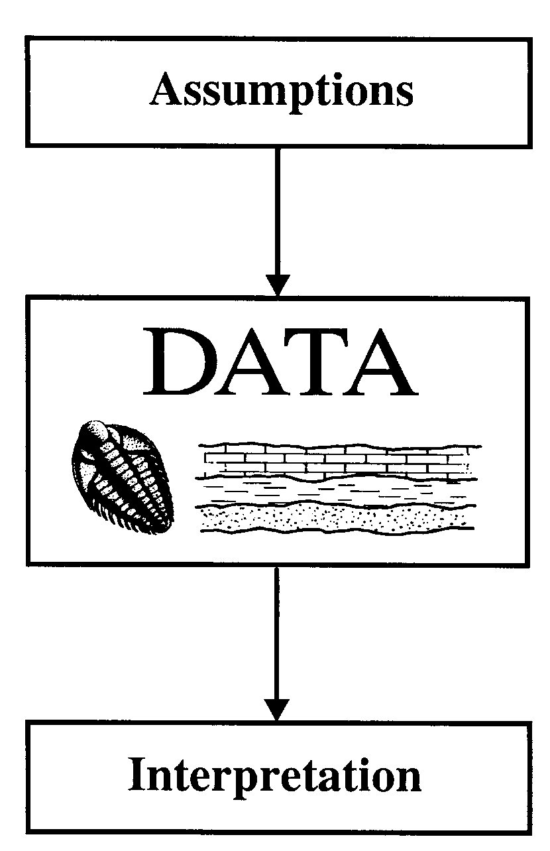
Assumptions Determine Interpretation

Slide 9
“It is not that the methods and institutions of science somehow compel us to accept a material explanation of the phenomenal world, but, on the contrary…”
Richard Lewontin
“Billions and Billions of Demons”
New York Review (Jan 9, 1997): p.31.

Slide 10
“…we are forced by our a priori adherence to material causes to create an apparatus of investigation and a set of concepts that produce material explanations, …”
Richard Lewontin
“Billions and Billions of Demons”
New York Review (Jan 9, 1997): p.31.

Slide 11
“we take the side of science in spite of the patent absurdity
of some of its constructs, in spite of the tolerance of the scientific community for unsubstantiated just-so stories, …”
Richard Lewontin
“Billions and Billions of Demons”
New York Review (Jan 9, 1997): p.31.

Slide 12
“…no matter how counterintuitive, no matter how mystifying to the uninitiated. Moreover, that materialism is an absolute,
for we cannot allow a Divine Foot in the door.”
Richard Lewontin
“Billions and Billions of Demons”
New York Review (Jan 9, 1997): p.31.

Slide 13
“Even if all the data point to an intelligent designer, such an hypothesis is excluded from science because it is not naturalistic.”
Dr. Scott Todd
An immunologist at Kansas State University
Correspondence to Nature
410(6752):423 (Sept 30, 1999)
<wwwanswersingenesis.org/todd>

Slide 14
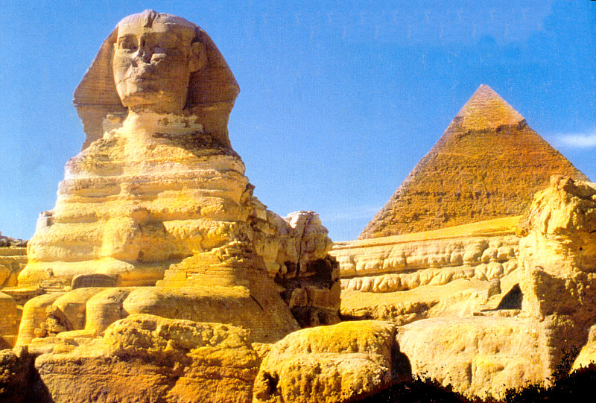

Slide 15
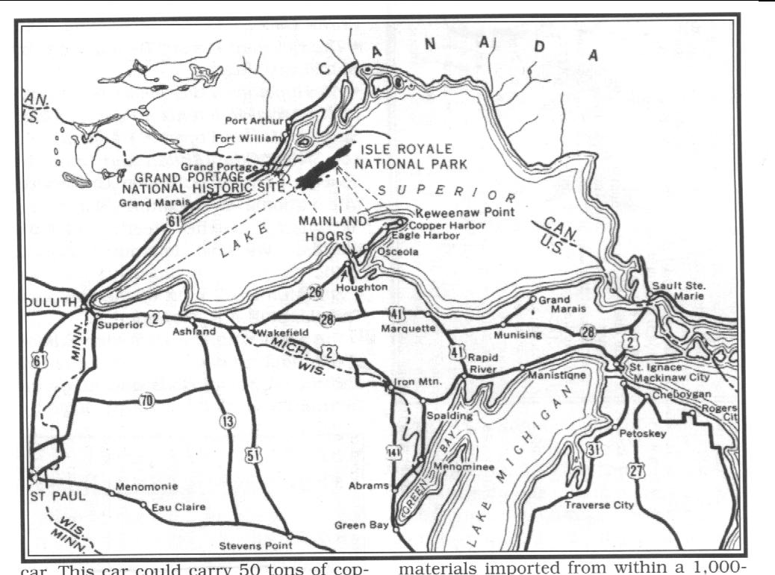
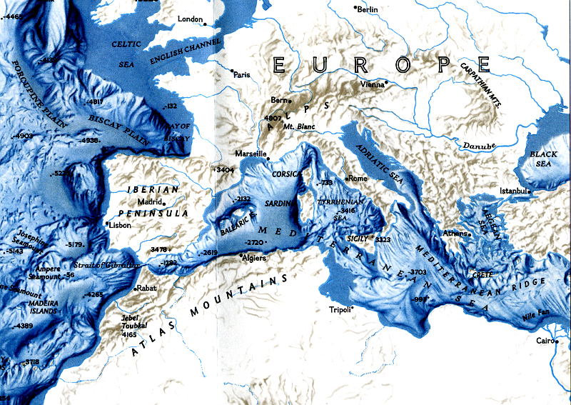
Ancient America, Vol. 8, Num 50
Notes:
15

Slide 16


Ankur Wat
Temple Complex
Cambodia

Slide 17
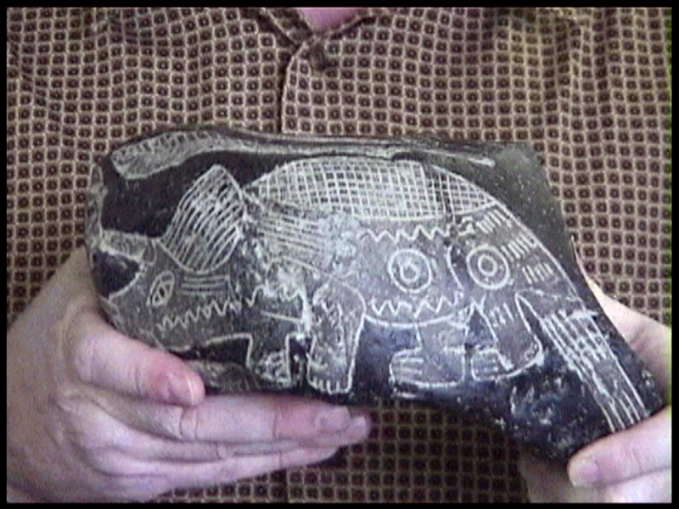

Slide 18
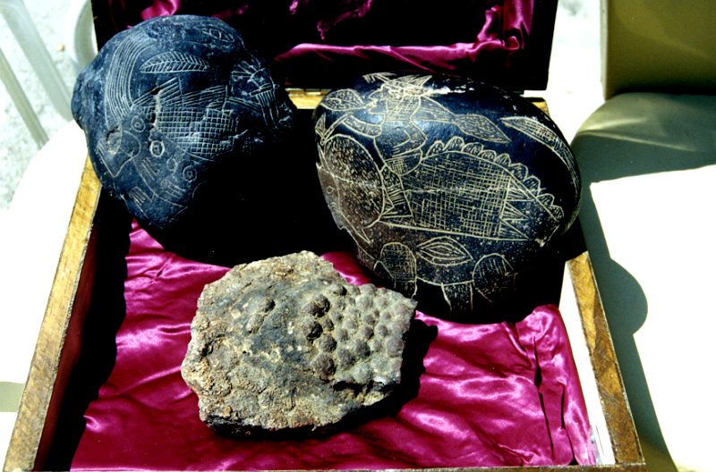
Fossilized dinosaur skin found in Bolivia. Notice the rosette patterns.
Now in Creation Evidences Museum, Glen Rose, TX.
Tim and Holly Nyquist of Santa Cruz, Bolivia found dinosaur skin. Mrs. Nyquist’s sister is Linda Mellen in Milton 850-983-3934.

Slide 19
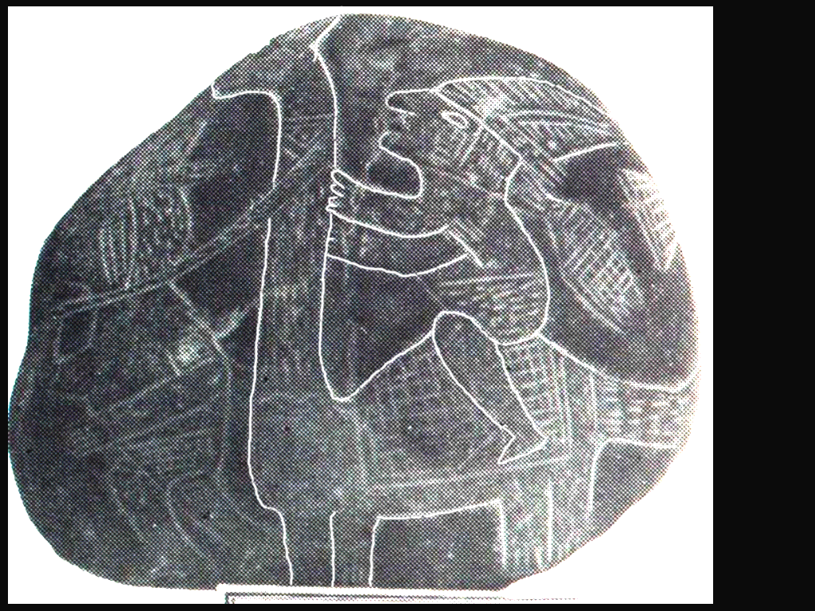
Pre-Inca Indian riding dinosaur
Pre-Inca Indian
riding a
dinosaur
and
NO
it’s
not
a llama!

Slide 20
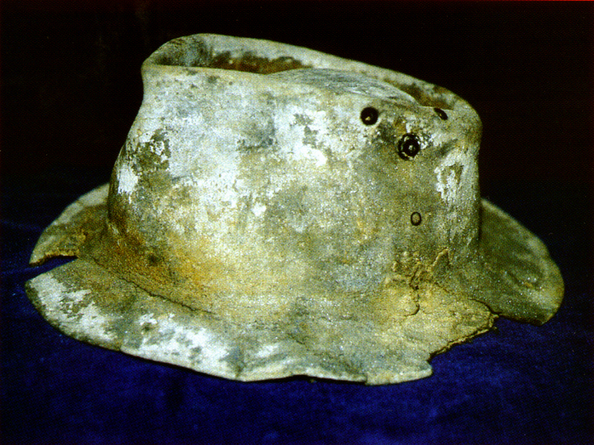
Petrified bowlers hat
found in New Zealand
Creation Magazine

Slide 21
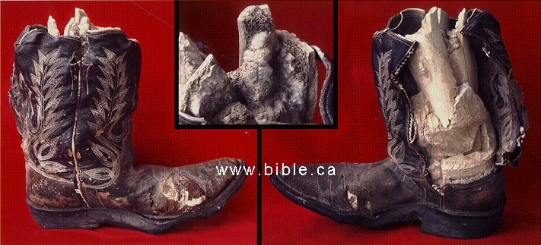
Petrified cowboy leg found in a dry creek bed near the West Texas town of Iraan, about 1980 by Mr. Jerry Stone, an employee of Corvette oil company.
The bones of the partial leg and foot within the boot were revealed by an elaborate set of C.T. Scans performed at Harris Methodist Hospital in Bedford, Texas on July 24, 1997. The Radiologic Technician was Evelyn Americus, AART. A complete set of these scans remains with the boot at the Creation Evidence Museum in Glen Rose, Texas. 254-897-3200

Slide 22
Some Indicated Earth Ages
Process | Age (Years)
Decay of earth’s magnetic field | 10,000
Influx of radiocarbon to earth system | 10,000
Growth of oldest living part of biosphere | 5,000
Origin of human civilizations | 5,000
Human population growth rates | 4,500
Decay of C14 in pre-Cambrian wood | 4,000
Formation of river deltas | 5,000
Influx of meteoritic dust from space | Very small
Accumulation of dust on the moon | 200,000
Influx of nickel to the ocean via rivers | 9,000
Influx of magnesium to the ocean via rivers | 45,000,000
Maximum life of meteor showers | 5,000,000

Slide 23
Hundreds of Physical Processes
Set Limits on the Age of the World
1. Helium in atmosphere
2. Helium in ground
3. Meteor dust
4. Buildup of carbon 14
5. Human population
6. Natural plutonium
7. Sodium in sea
8. Sediment in sea
9. Erosion of continents
21. Coral reef growth
22. Oldest living plants
23. Human civilizations
24. River delta growth
25. Undersea oil seepage
26. Uranium in sea
27. Neutrons and lead
28. Rotation of spiral galaxies
29. Interstellar gas expansion
30. C-14 in meteorites
31. Decay of comets
32. Interplanetary dust removal
33. Lifetime of meteor showers
34. Dust on the moon
35. Slowing of earth's rotation
36. Heat loss from earth
41. Peat bog growth
42. Multi-layer fossils
43. Hardening of rocks
44. Decay of Saturn's rings
45. Potassium in the sea
46. Titan's methane loss
47. Internal heat of Io
48. Leaching of chlorine
49. Radiogenic lead
50. Niagra Falls erosion
51. Stone age burials
52. Seafloor calareceous ooze
53. Uranium decay
54. Squashed radiohalos
55. Young water to sea
56. Magma to earth's crust
10. Earth's magnetic field
11. Oil leaks in earth
12. Natural gas in earth
13. Orphan radiohalos
14. Neutrons and strontium
15. Decay of rock magnetism
16. Tight bends in rocks
More than 90 % of these processes
give an age less than billions of years
Source: Russell Humphreys, Ph.D.
Notes:
3
I've been collecting such data for 25 years. I know of only a few dozen processes — radiologic dating, etc. — which seem to favor a world billions of years old The news media have popularized such processes, and you can find them listed in many books.
But I know of over over a hundred processes favoring a young world, and I suspect that my list is far from complete. Other creationist scientists keep adding things I haven't thought of. So I suspect that if we put everybody's lists together there would be at least 200 items.
So only a few dozen out of several hundred processes suggest the world is billions of years old; most of the processes suggest an age much less than that.
How do we resolve the conflict between "old" and "young" data? It makes more sense scientifically to start off with the hypothesis that the majority of the data ("young") is correct taken at face value, and then try to understand the minority of data ("old").
I want to concentrate on the 90 % and barely touch on the 10%.
But there is one important thing you need to understand about all of these processes ...

Slide 24
Richard Dawkins, “The Blind Watchmaker”, P1
“Biology is the study of complicated things that give the appearance of having been designed for a purpose.”

Slide 25
Francis Crick, Natural History, v.97, 1988
“What Mad Pursuit”, p.138, 1988
“Biologists must constantly keep in mind that what they see was not designed,
but rather evolved.”

Slide 26
Douglas Futuyma, Science On Trial, p.169
“Creation and evolution, between them, exhaust the possible explanations for the origin of living things. Organisms either appeared on earth fully developed or they did not. If they did not, they must have developed from preexisting species from some process of modifications.”

Slide 27
“Evolution is unproved and unprovable. We believe it only because
the only alternative is special creation, and
that is unthinkable.”
Sir Arthur Keith
wrote the forward to the
100th anniversary edition
Origin of Species in 1959

Slide 28
Edward L. Erickson, The Humanist
9-10/2000, p.30
“The core of the humanistic philosophy is naturalism – the proposition that the natural world proceeds according to its own internal dynamics, without divine or supernatural control or guidance, and that we human beings are creations of that process.”

Slide 29
Steven Pinker, MIT, How The Mind Works, p.162
“No evidence would be sufficient to create a change in mind; that it is not a commitment to evidence, but a commitment to naturalism.
… Because there are no alternatives, we would almost have to accept natural selection as the explanation of life on this planet even if there were
no evidence for it.”

Slide 30
Isaac Asimov, Counting The Eons, p.10
“I have faith and belief myself… I believe that nothing beyond those natural laws is needed. I have no evidence for this. It is simply what I have faith in and what I believe.”

Slide 31
Michael Ruse, Philosophy of Science, FSU
National Post, 5/13/2000, p. B-3
“Evolution is promoted by its practitioners as more than mere science. Evolution is promulgated as an ideology, a secular religion – a full-fledged alternative to Christianity, with it meaning and morality…Evolution is a religion.”

Slide 32
World Net Daily, August 20, 2006
“A federal court of appeals ruled yesterday…Atheism is religion… the 7th Circuit Court of Appeals”

Slide 33
Museum President John McCarter
Chicago Tribune, September 14, 2006
Chicago Field Museum Of Natural History
“The whole core of the museum is evolution and its story… In recent years has dedicated a lot of resources to educate visitors about evolution. That includes spending $17 million and two years to recast its permanent exhibit on evolution.”

Slide 34
John Chaikowsky, “Geology vs. Physics”
Geotimes, vol. 50, April 2005, p6
Evolutionists have “Physics Envy”. They tell the public that the science behind evolution is the same science that sent people to the moon and cures diseases. It’s not.

Slide 35
John Chaikowsky, “Geology vs. Physics”
Geotimes, vol. 50, April 2005, p6
The science behind evolution is not empirical, but forensic.
Because evolution took place in history, its scientific investigations are after the fact –
no testing, no observations,
no repeatability, no falsification, nothing at all like physics.

Slide 36
John Chaikowsky, “Geology vs. Physics”
Geotimes, vol. 50, April 2005, p6
I think this is what the public discerns –
that evolution is just a bunch of just-so stories disguised as legitimate science.

Slide 37
“Even if all the data point to an intelligent designer, such an hypothesis is excluded from science because it is not naturalistic.”
Dr. Scott Todd
An immunologist at Kansas State University
Correspondence to Nature
410(6752):423 (Sept 30, 1999)

Slide 38
“Evolution is unproved and unprovable. We believe it only because
the only alternative is special creation, and
that is unthinkable.”
Sir Arthur Keith
wrote the forward to the
100th anniversary edition
Origin of Species in 1959

Slide 39
Recent Creation
Earth’s Spin
Earth to Moon
Magnetic Field
Sea Salts
Helium
Comets
Hot Moons
Spiral Galaxies
Populations
Ice Depth
Oldest Desert
Oldest Plant
Oldest Coral
Cave Formations

Slide 40
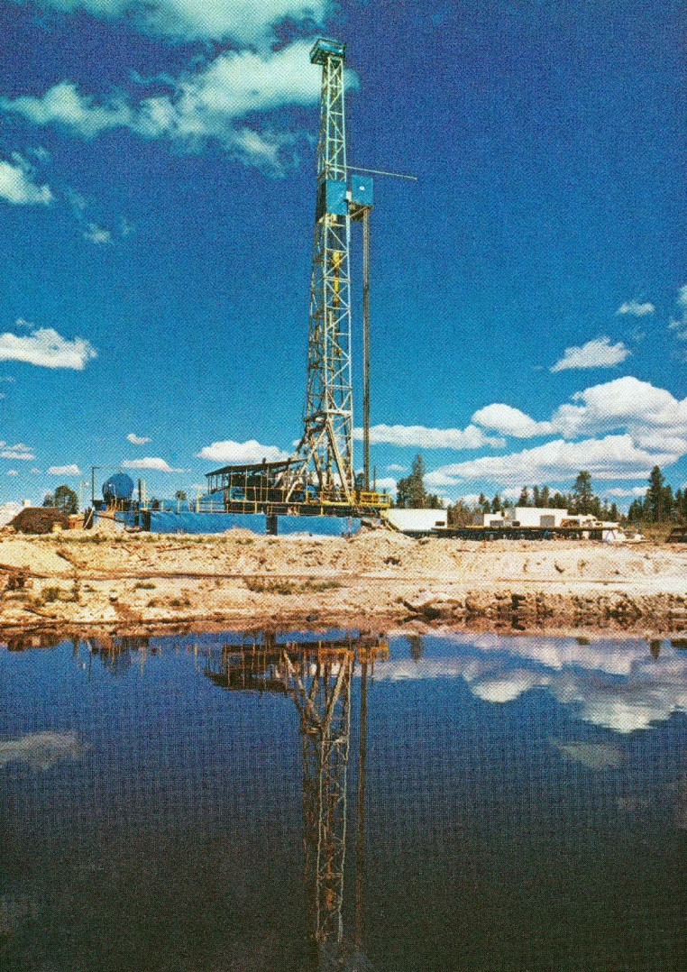
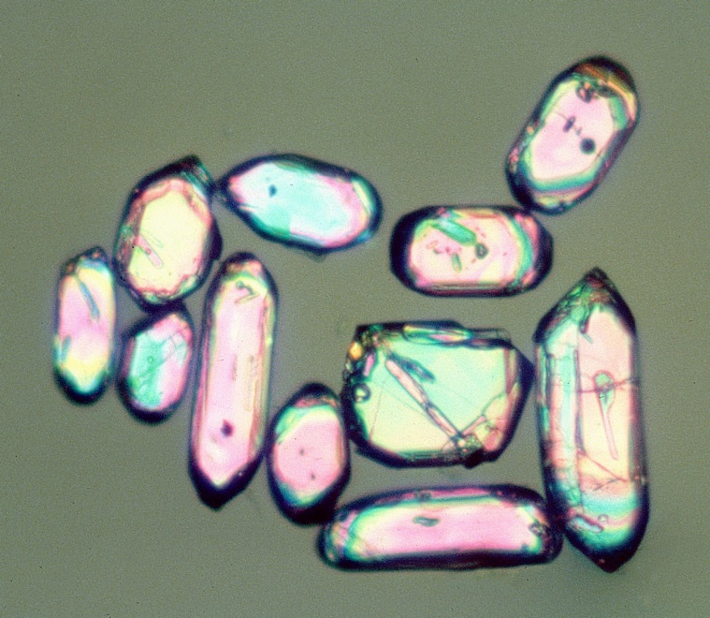
Brochure item 10
Helium leakage from radioactive
zircons deflates “Billions of years”
Microscopic zircon crystals
60 µm
Notes:
In 1974 near Los Alamos from 3 miles deep.
Show samples of Sandia granite --- same formation
Let’s look closer at the rock the zircons came from.

Slide 41
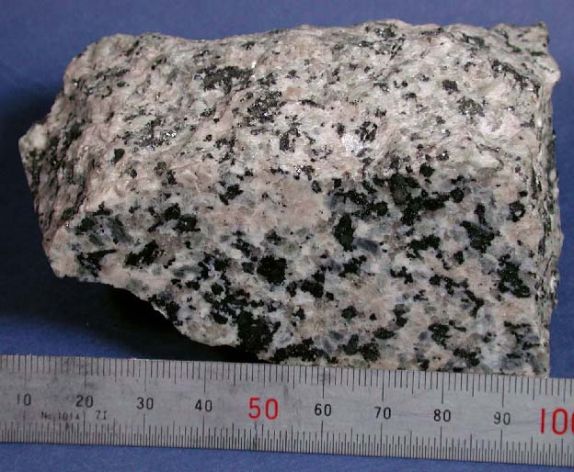
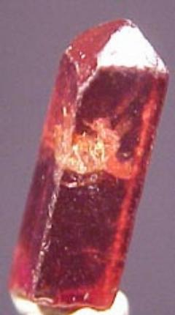
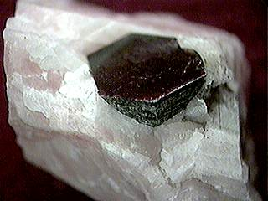
Zircons come from granitic rock
Zircon
Contain
Uranium
Biotite (mica)
Notes:
Black mica = biotite. Zircons embedded in that. ZrSiO4 (not “Cubic zirconias”) = Biblical Jacinth
Zircons are radioactive. Take a close look at radioactivity in a zircon …

Slide 42

Uranium decay makes helium and lead
Zircon
60 µm long
U-238
Helium atoms
Uranium-lead age:
“1.5 Billion years”
Nuclear decay
Pb-206
Notes:
U and Th in zircon decays to lead. The nuclear decay makes helium (alphas) in zircons, eight per Pb-206 atom.
That lets us calculate how much helium the decay originally deposited in the crystal. 1.5 billion years worth (at today’s rates) of lead.
Helium can leave the zircon ...

Slide 43
Helium leaks into surrounding mica
Biotite
How much helium leaked?
Notes:
We found some Helium in this biotite, but much is still in the zircons.
Let’s look at the amounts ...

Slide 44

Much helium is still in the zircons
Depth (miles) | Temp. (ºC) | Helium (%)
0.5 | 95
0.6 | 105
0.9 | 124
1.4 | 151
1.8 | 197
2.2 | 239
2.5 | 277
80
58
42
27
17
1.2
0.1
Notes:
Deeper = hotter = faster diffusion (= leakage) The helium hasn’t had time to leak out of the zircons.
Suggests a dating method --- if we knew rates. We didn’t know, so we calculated them in advance.
First let’s prepare a graph ...

Slide 45
We’ll plot leak rate versus temperature
Diffusivity (cm²/sec)
Faster Leakage
Hotter zircons
Temperature (°C)
Notes:
Horizontal scale reversed from traditional Arrhenius plot (log inverse absolute temp versus log diffusivity.
Vertical scale is very compressed --- factor of one trillion top to bottom.
Let’s plot leak rates on this graph …

Slide 46
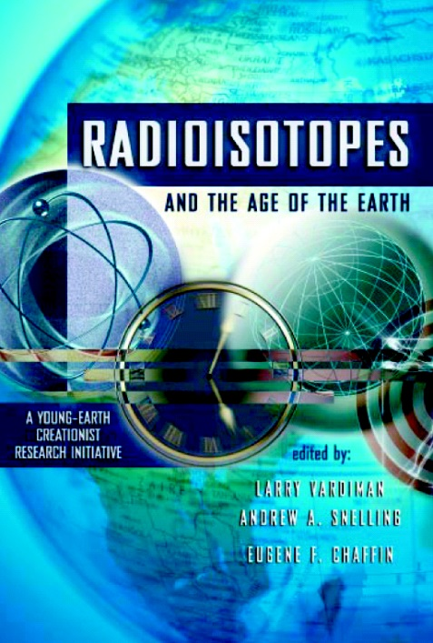
First we predicted leak rates
Published in
2000 A.D
6,000 years
0.1
Diffusivity (cm²/sec)
1.2
Factor of
100,000
27
17
42
58
1.5 Billion years
Temperature (°C)
Notes:
Roughly, at each temp, divide Helium lost by time. Different times give different leak rates. 6,000 years from Bible.
2-sigma error bars show 95% confidence limits. Black numbers are % retentions. Published in year 2000, chapter 7, figure 7.
Next we tested the predictions with experiments …

Slide 47
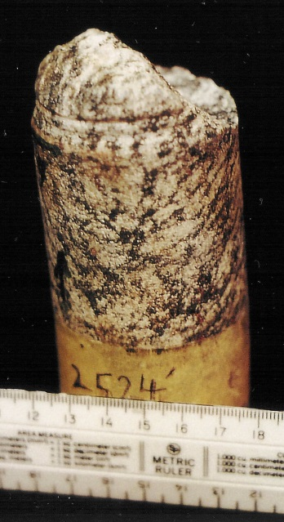
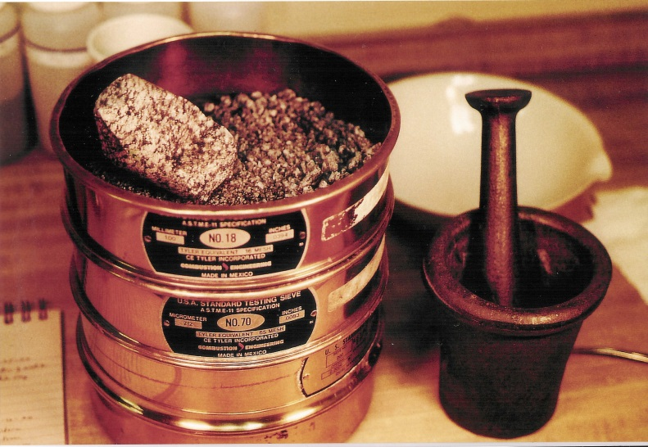
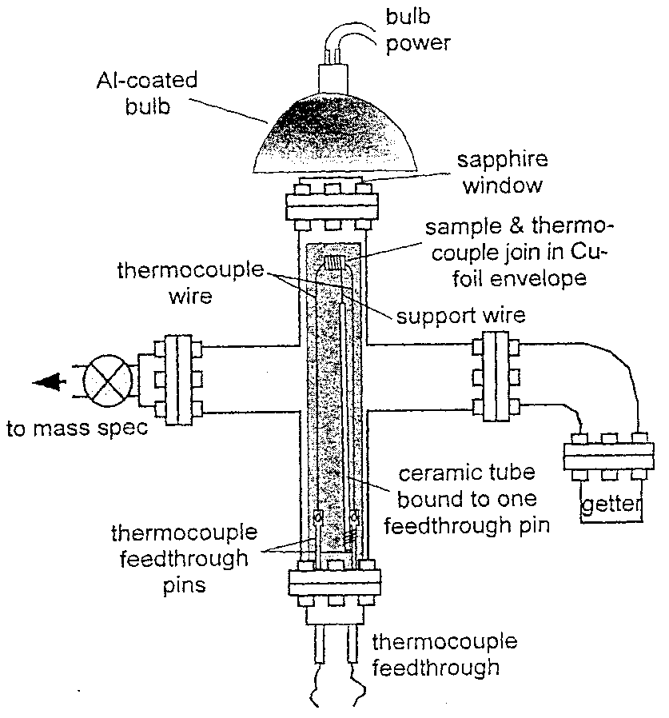
We commissioned helium leak experiments
Compare measured rates (2003)
with our predicted rates (2000)
Notes:
Apparatus In Analytical Chemistry May 15 1999. Commissioned world expert in this field
He didn’t know our goals, or our prediction of his results.
Let’s compare prediction and results…

Slide 48
Here’s the prediction, again
Diffusivity (cm²/sec)
6,000 years
1.5 Billion years
Temperature (°C)
Notes:
Now let’s plot the data on this same graph …

Slide 49
The data fit the 6,000-year prediction
Data
Diffusivity (cm²/sec)
6,000 years
1.5 Billion years
Temperature (°C)
Notes:
Measured data = blue dots. Error bars 95% confidence limits
Data fall right on the 6,000 year prediction. Data totally reject the 1.5 billion years
Next we get a helium leak date …

Slide 50

The leak rates are so high
that the zircons must be very young
Measured losses
6,000 years
± 2000 years
=
Measured leak rates
Notes:
Roughly, divide measured losses by measured rates = 5681 +/- 1999 years. I didn’t plan this result!
Let’s sum up what this means …

Slide 51
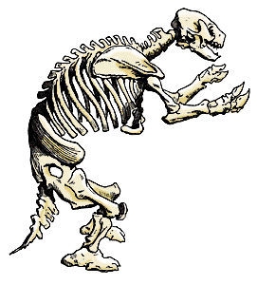
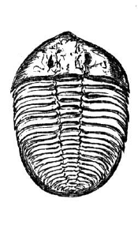
Old fossils should have no carbon 14
Brochure item 11
C-14 Half-life: 5,700 years
No C-14 left after 0.25 million years
Below Ice Age: “2 million to 560 Million” years
Notes:
Not one C14 atom in a fossil after 250,000 years.
So all the fossils below the Ice Age strata “should” have zero C-14
Is that really so? No …

Slide 52
All fossils have much carbon 14
From carbon dating journals:
Age (in years):
Coal, wood, shells,
bone, marble, natural
gas, CO₂, calcite, oil.
Conventional : Millions
Standard C-14: < 70,000
Number of samples
Corrected C-14: ~5,000
Contamination?
We tested that assumption …
¹⁴C/C (% of ratio in modern carbon)
Machine
Accuracy
0.001
Assumed Standard
“Background” 0.077
Notes:
This is new for most people, a trade secret of the carbon dating labs for 20 years. But it is still in fossils supposed to be 600 million years old. C-14 date: 30 to 70 kyr. Error: X 10,000 ! We checked with 10 coal samples. Genesis flood shortens C-14 age to 5,000 years. Carbon 14 is now the creationists’ friend!
Labs had claimed contamination with recent carbon. We now have a terrific answer to that ….

Slide 53
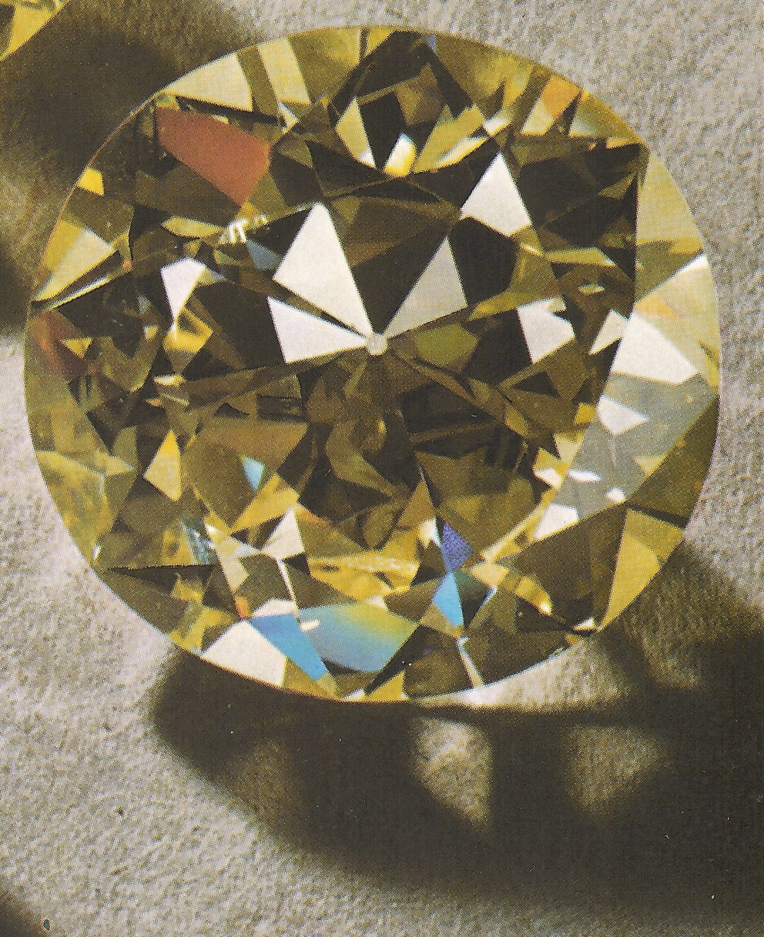
Even diamonds have young C-14 ages
Can’t contaminate internally!
Didn’t contaminate externally
— World’s best C-14 lab
— Specialty: small amounts
— 20 years experience
From depths of earth
Age (in years):
Conventional: Billions
Standard C-14: 58,000
Corrected C-14: <10,000
Notes:
Diamonds harder than anything but the human heart. They’re confident the C14 is intrinsic.
From the Earth’s mantle --- 20 miles below us
Here are the data …

Slide 54
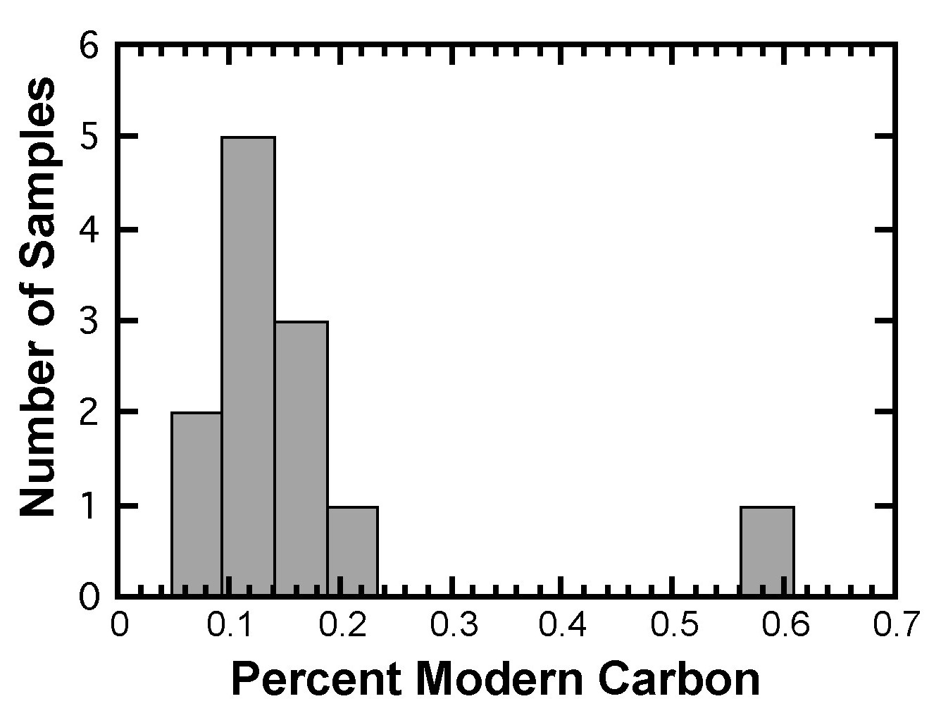
Latest data look good
12 diamonds from:
5 different mines
7 different gravels
Underground neutrons?
10,000 times too low
¹⁴C/C,
Machine
Accuracy
0.001
Assumed Standard
“Background” 0.077
Notes:
100 x greater than machine accuracy threshold. Greater than “background” standard, Icelandic Spar
Less than 33 neutrons/cc per year deep underground on N-14 in diamonds make C-14 --- not nearly enough!
Let’s sum up what this means …

Slide 55
The most foolproof method to compare four types of nuclear dates:
“Mineral isochron”
dating in a single rock:
1. Uranium–Lead 1.25BY
2. Potassium-Argon 0.85BY
3. Samarium-Neodymium 1.35BY
4. Rubidium-Strontium 1.05BY
Notes:
Let’s see the results …

Slide 56
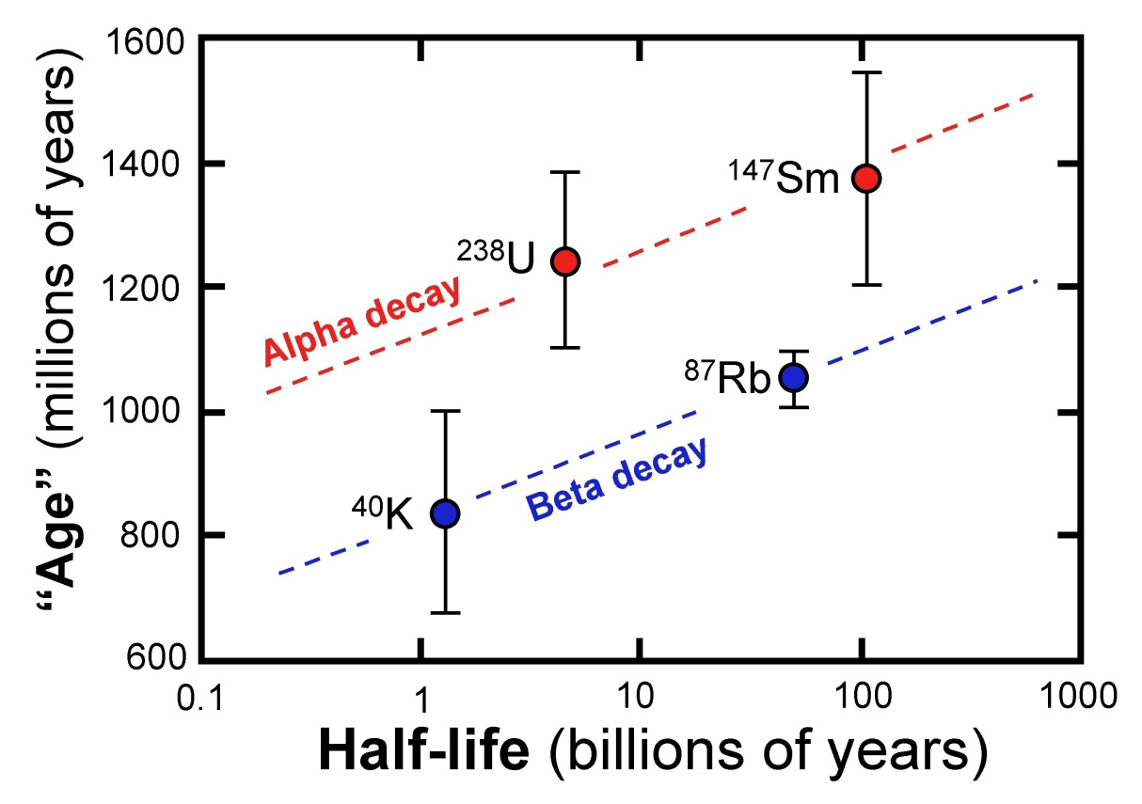
We got four very different “ages” for the same rock
Bass Rapids Diabase Sill, Grand Canyon
“Age” orders:
Alpha > Beta
Long ½life > Short ½life
Same for other rocks
Points to differences in decay speedup
Notes:
Steve presented this and other similar results to the Geological Society of America at several of their meetings.
Let’s see what RATE’s nuclear theorist says about this …

Slide 57
Nuclear theory explains our results
Chaffin
50% weaker nuclear force:
Affects α more directly than β
Speeds up slow decays greatly
Doesn’t speed up fast decays much
Potassium-40 speeded up billionfold
Carbon 14 not affected much
Notes:
Technical articles available. Here’s one …

Slide 58
Basalt from Mt. Etna, Sicily (122 BC) gave K-AR age of 250,000 years old.
Dalyrmple, G.B., 1969 40Ar/36Ar analysis of historic lava flows. Earth and Planetary Science Letters, 6-47 55. See also: Impact #307 Jan. 1999

Slide 59
Lava from the 1801 Hawaiian volcano eruption gave a K-Ar date of 1.6 Million years old.
Dalyrmple, G.B., 1969 40Ar/36Ar analysis of historic lava flows. Earth and Planetary Science Letters, 6-47 55. See also: Impact #307 Jan. 1999

Slide 60
Basalt from Mt. Kilauea Iki, Hawaii (AD 1959) gave K-AR age of 8,500,000 years old.
Impact #307 Jan. 1999
See also: Creation Ex Nihilo Dec. 1999, p. 18

Slide 61
Basalt from Mt. Etna, Sicily (AD 1964) gave K-AR age of 700,000 years old.
Impact #307 Jan. 1999, ICR.ORG

Slide 62
Basalt from Mt. Etna, Sicily (AD 1972) gave K-AR age of 350,000 years old.
Impact #307 Jan. 1999, ICR.ORG

Slide 63
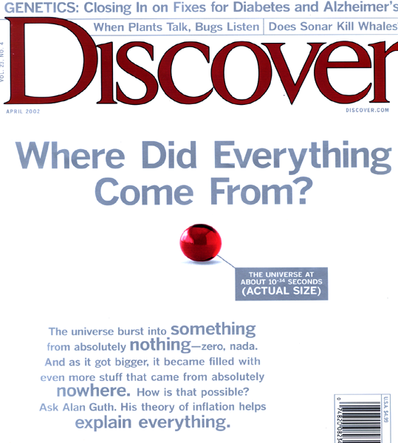

April 2002

Slide 64

Little girl and chimp--differences
Kid’s can
talk
learn
think
abstractly
make moral
decisions
create things
Chimps can’t!
Notes:
The letters and words are identical, but the meaning is opposite because of grammar and syntax.
Geneticists have identified the letters and words of the genome, but know nothing of the grammar and syntax of the DNA language (said Dr. Tom Wood, a geneticist, in his paper at ICC 2003).
So the DNA similarities between apes and man are really meaningless. It is obvious to us all that there are very significant differences between the two and only superficial similarities.
Chimp & child photo is mine

Slide 65
Some Creation Web Sites
www.answersingenesis.org
www.creationresearch.org
www.drdino.com
www.evolutiondeceit.com
www.halos.com
www.icr.org
www.nwcreation.net
www.rae.org
www.yecs.org

Slide 66
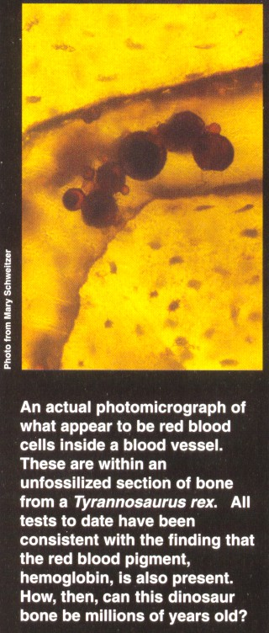
“A medical pathologist examined dinosaur bone under a microscope and found dinosaur blood inside the bone.”
Earth, June 1997, pp. 55-57

Slide 67
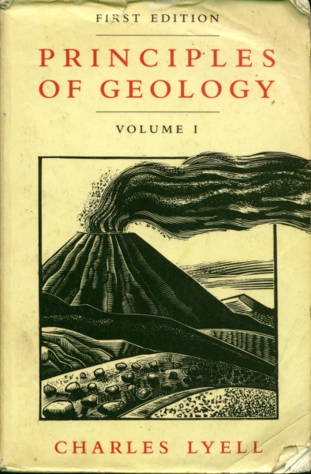
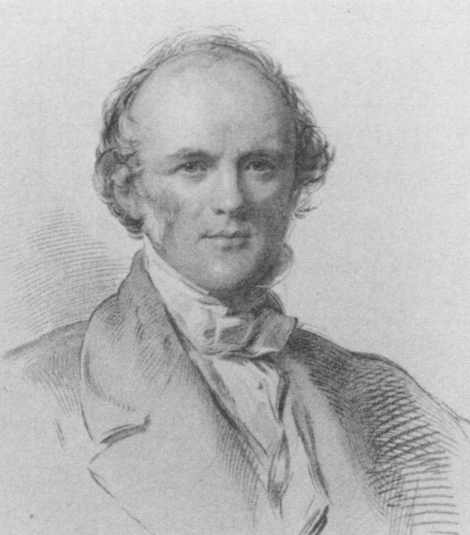
Principles of Geology
1830
Scottish lawyer
Charles Lyell
In the Minds of Men, p. 69
Notes:
Built on the work of James Hutton.

Slide 68
Charles Lyell said
his goal was to
“free the science
from Moses”
Life Letters and Journals, published by John Murray 1881.

Slide 69
Facts
Interpretation Framework
Assumptions Beliefs
Notes:
Two features: Layers and Canyon. Two ways of looking: a long time and a little water OR a little time and a lot of water.
We only have the present – how do we interpret the past?

Slide 70
Three Kinds of Science
Operational*
  Observable
  Testable
  Repeatable
  Experiments
  Technology
Theoretical
  Observable
  Not testable
  Not repeatable
  Interpretation
  Simulations
Historical*
  Not observable
  Not testable
  Not repeatable
  Interpretation
  Imagination
*Empirical
*Forensic

Slide 71
